Slide 1
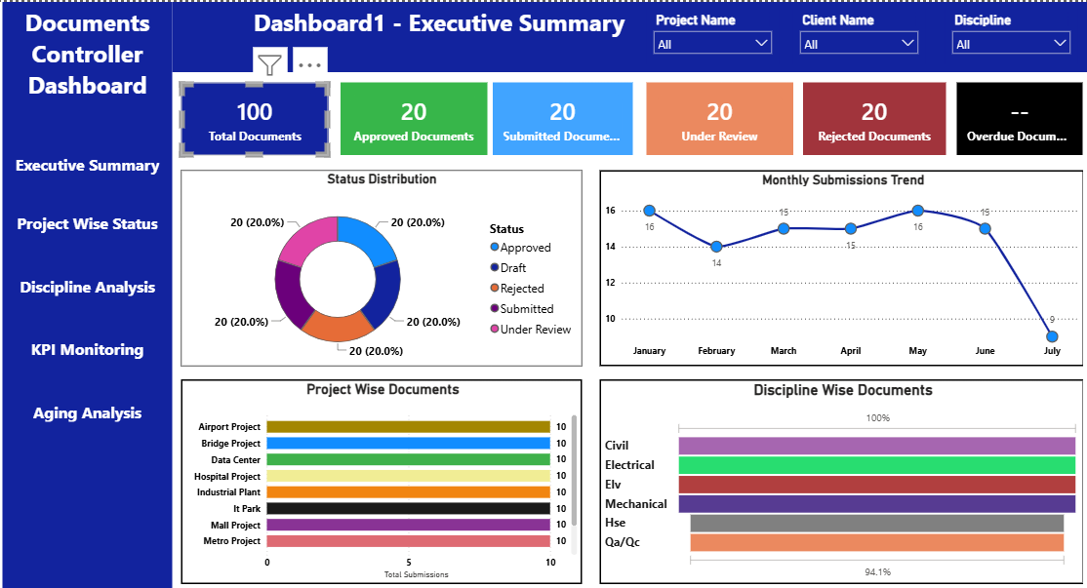
DOCUMENT CONTROL Dashboard- Management Presentation
This dashboard provides an overall view of document control activities, including total document volume, current status, submission trends, and project-wise and discipline-wise performance. It also highlights pending and overdue documents, helping management identify delays, prioritize actions, and maintain effective document control.
It helps management monitor document flow and quickly identify areas that require attention.
The dashboard supports timely follow-up, better coordination, and effective project control.

Slide 2
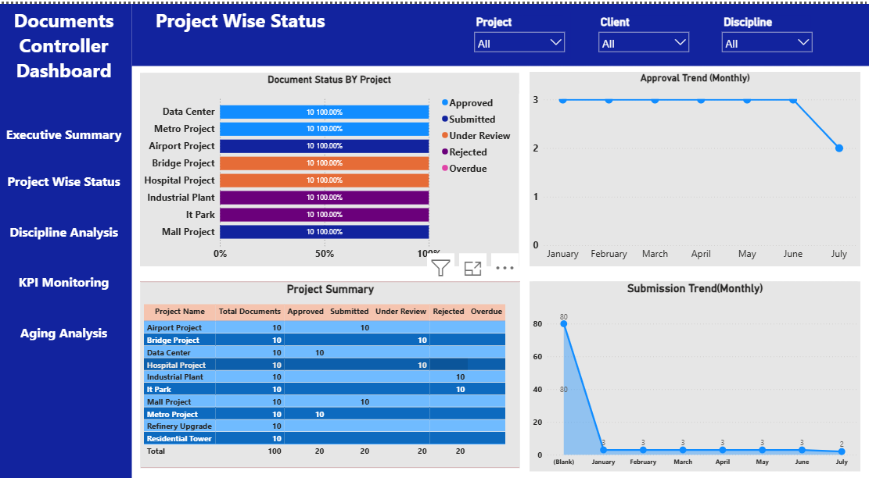
01 Executive Summary
Overall Document Status: Provides visibility of total documents and their current status, including Approved, Submitted, Under Review, Rejected, and Overdue documents.
Status Distribution: Highlights the proportion of documents at each stage of the document review and approval cycle.
Monthly Submission Trend: Tracks document submissions month-by-month to identify workload patterns and changes in submission performance.
Project-Wise Performance: Compares document submissions across different projects and highlights variations in document activity.
Project-Wise Performance: Compares document submissions across different projects and highlights variations in document activity.
Discipline-Wise Analysis: Shows the distribution of documents across major disciplines such as Civil, Electrical, ELV, Mechanical, HSE, and QA/QC.

Slide 3

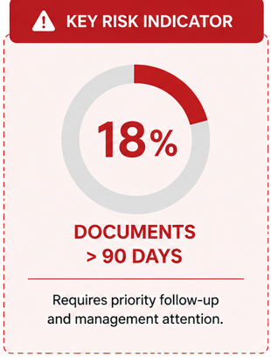

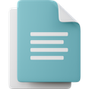



03 | RISKS & BOTTLENECKS
Key risks and bottlenecks impacting document control performance and timely project delivery.
01 | LONG-PENDING DOCUMENTS
Documents remaining under review for an extended period can delay final closure and affect document flow.
02 | APPROVAL DELAYS
Slow review and approval cycles may create bottlenecks and impact planned submission/closure timelines.
03 | OVERDUE DOCUMENTS
Documents exceeding the expected timeline require immediate follow-up and escalation.
04 | REPEATED REJECTIONS
Frequent document rejections can indicate issues with quality, completeness, or compliance.
05 | PENDING ACTIONS
Delayed responses or actions from responsible teams can increase document aging and backlog.
Key bottlenecks are primarily associated with document aging, approval delays, overdue submissions,
repeated rejections, and pending actions.

Slide 4

04 Recommendations
01 | Strengthen Follow-Up Regularly track pending and overdue documents to ensure timely action.
02 | Clear Ownership Assign responsible persons and target closure dates for pending documents.
03 | Prioritize Critical Items Focus on long-pending and high-priority documents requiring immediate attention.
04 | Improve Review Cycle Coordinate with reviewers to reduce approval and response delays.
05 | Monitor Rejections Identify common rejection reasons and improve document quality before submission.
06 | Management Review Include KPI, aging, and pending status in regular project review meetings.
Expected Outcome
Faster Closure | Reduced Aging | Better Compliance | Improved Document Flow

Slide 5
04 Aging Analysis & Management Action
30–60 Days
Improve Review & Approval Cycle Reduce response time through regular coordination with review teams.
Immediate Action
Identify Critical & Overdue Documents Prioritize long-pending documents and initiate immediate follow-up.
0–30 Days
Strengthen Ownership & Follow-Up Assign responsible owners and define clear target closure dates.
30–60 Days
Improve Review & Approval Cycle Reduce response time through regular coordination with review teams.
60–90 Days
KPI & Aging Monitoring Track KPI performance and aging trends to measure improvement.
Ongoing
Continuous Monitoring & Management Review Conduct regular reviews and implement corrective actions where required.
“The improvement plan focuses on reducing document aging, strengthening accountability, improving approval turnaround, and maintaining continuous performance monitoring.”

